Slide 1

RFID Sensor module

Slide 2
What is RFID ?
RFID is short for “radio-frequency identification” and points to a technology whereby a reader catches digital information encoded in RFID tags or smart labels via radio waves.
RFID systems use radio waves at several different frequencies to transfer data.

Slide 3
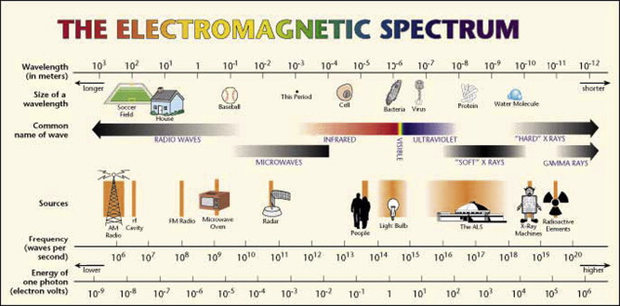

Slide 4
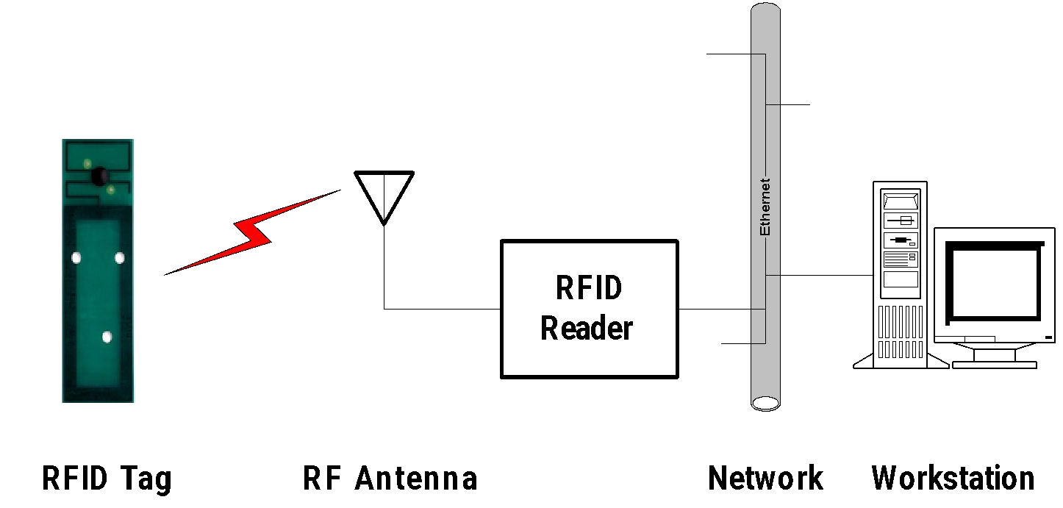
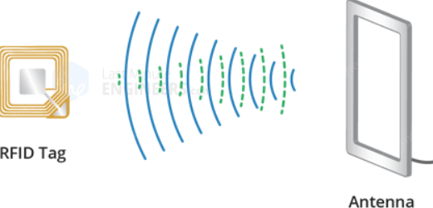
RFID system components

Slide 5
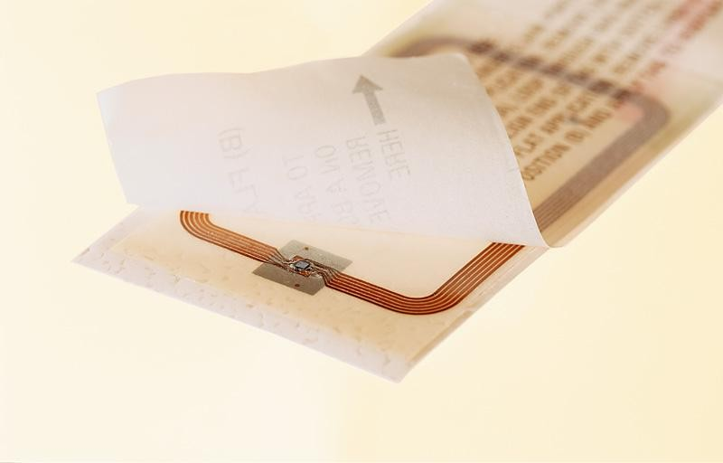
RFID tags: Smart labels
A paper label with RFID inside
an antenna, printed, etched or stamped ...
… and a chip attached to it
… on a substrate
e.g. a plastic foil ...

Slide 6
Antenna fields: Inductive coupling
IC or microprocessor
Transceiver Tag Reader
RFID
Tag
antenna
antenna
5

Slide 7
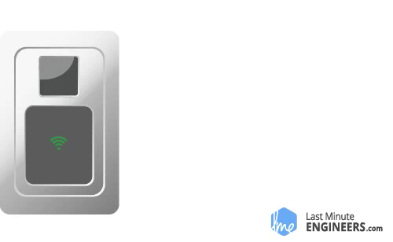
HOW RFID WORKS

Slide 8
RFID applications
Manufacturing and Processing
Inventory and production process monitoring
Warehouse order fulfillment
Supply Chain Management
Inventory tracking systems
Logistics management
Retail
Inventory control and customer insight
Auto checkout with reverse logistics
Security
Access control
Counterfeiting and Theft control/prevention
Location Tracking
Traffic movement control and parking management
Wildlife/Livestock monitoring and tracking
6

Slide 9
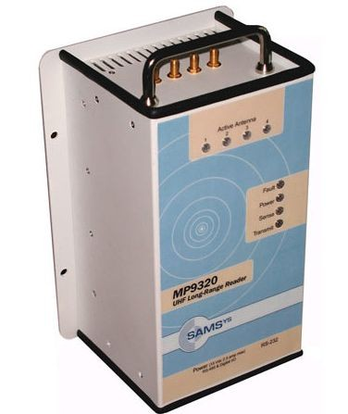
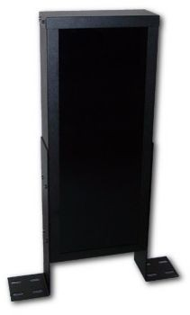
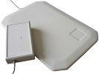
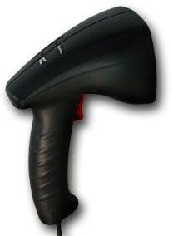
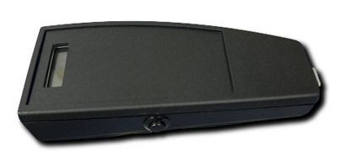
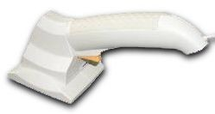

Some RFID readers
7

Slide 10
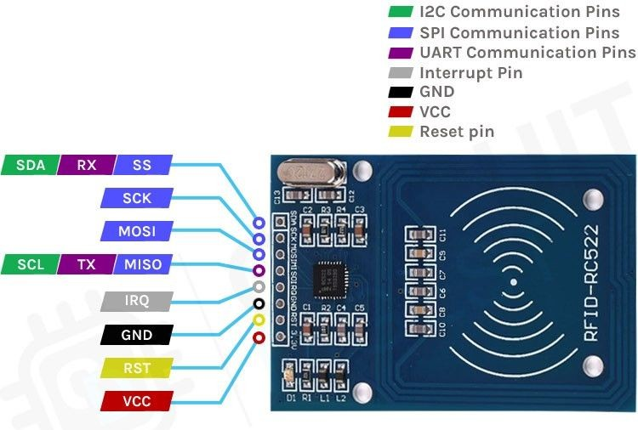
RFID Module pin outputs

Slide 11
Pin Functions:
1. SDA (Slave Select/Chip Select - SS)
Purpose: Acts as a selection line for the RFID module. It tells the RFID module whether it is being addressed or not.
How it works:
When low, the RFID module is selected and ready to communicate.
When high, the RFID module is inactive, allowing other devices on the SPI bus to operate.
2. SCK (Serial Clock)
Purpose: Provides the clock signal to synchronize data transfer between the microcontroller and the RFID module.
How it works:
The microcontroller generates the clock, and the RFID module uses it to shift data in or out on MOSI or MISO lines.
The speed of communication is determined by this clock signal.

Slide 12
3. MOSI (Master Out Slave In)
Purpose: Used to send data from the microcontroller (master) to the RFID module (slave).
How it works:
For example, the microcontroller sends commands to configure the RFID module or transmit data.
5. IRQ (Interrupt Request)
Purpose: Used to signal the microcontroller that an event has occurred on the RFID module.
When it triggers:
When a card is detected, or data is ready to be read or written.
It reduces the need for continuous polling, saving processor time.
4. MISO (Master In Slave Out)
Purpose: Used to send data from the RFID module (slave) to the microcontroller (master).
How it works:
For example, the RFID module sends tag information or status back to the microcontroller.

Slide 13
How They Work Together in SPI Communication:
Microcontroller as Master:
It generates the clock (SCK).
It sends data to the RFID module using MOSI.
It reads data from the RFID module using MISO.
RFID as Slave:
It listens to the commands on MOSI.
It sends responses or data on MISO.
It toggles IRQ to inform the microcontroller about events (optional).
SDA manages control:
Ensures only one device communicates on the SPI bus by selecting/deselecting the RFID module.

Slide 14
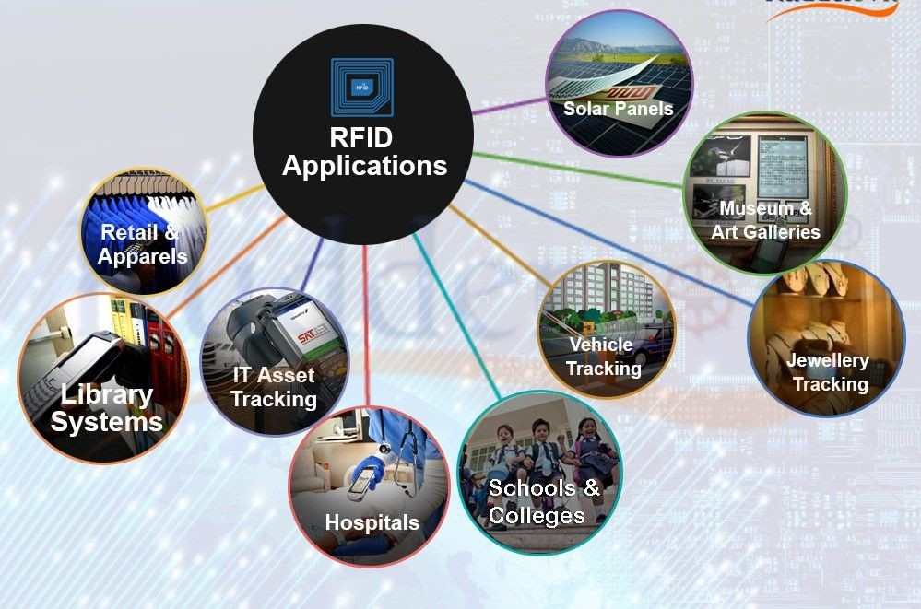
Application of RFID

